Slide 1
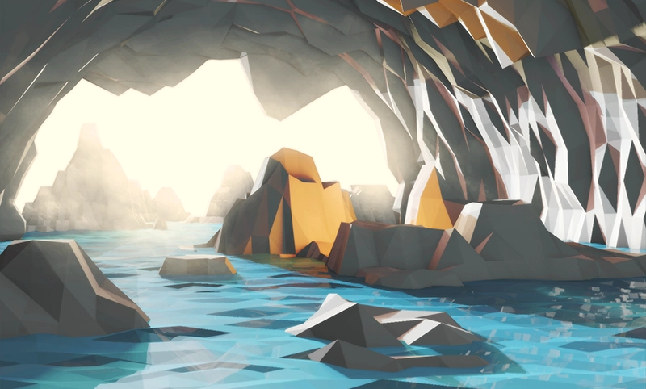
Notes:
1 - Entrance
2 - Entrance Encounter
3 - Entrance Puzzle
4 - Air Temple
5 - Earth Temple
6 - Fire Temple
7 - Water Temple

Slide 2
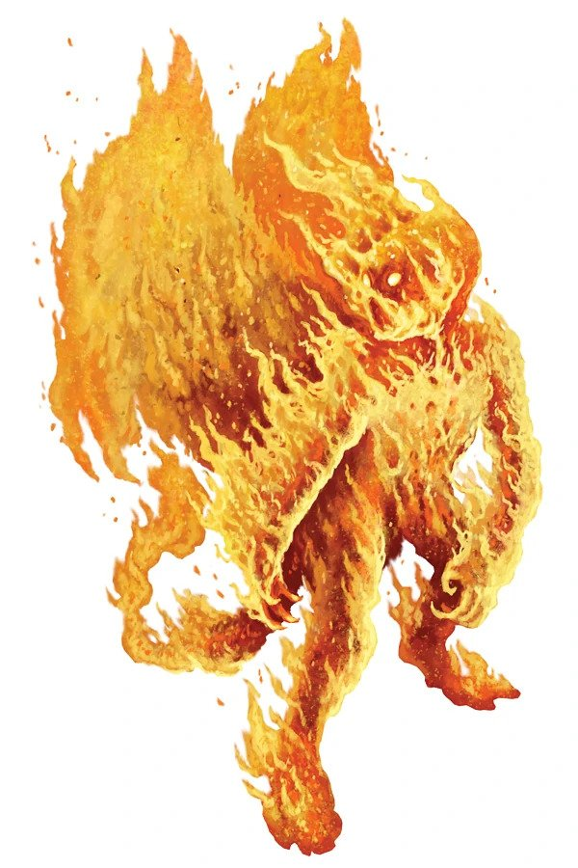
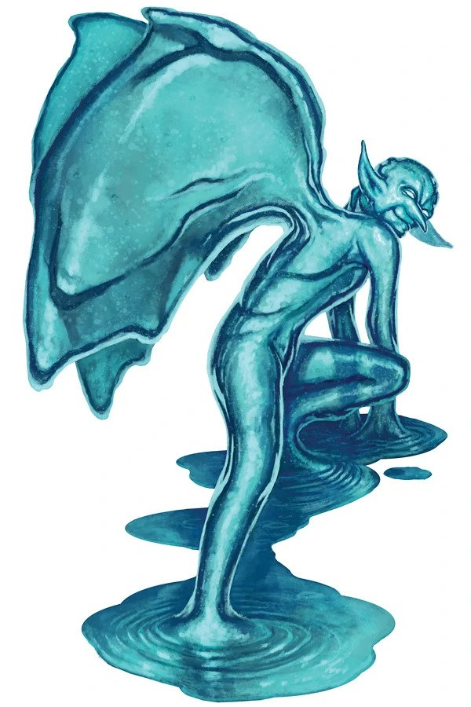
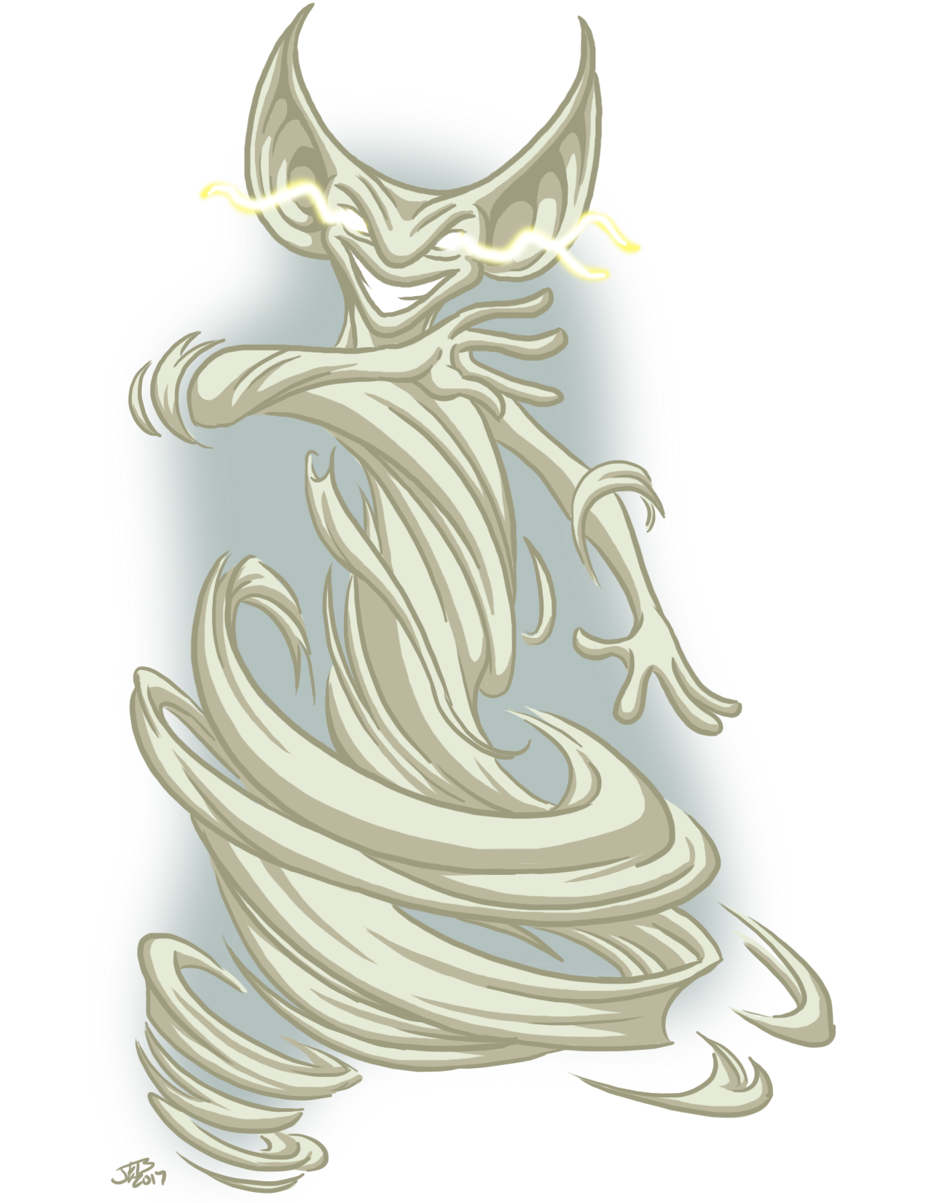
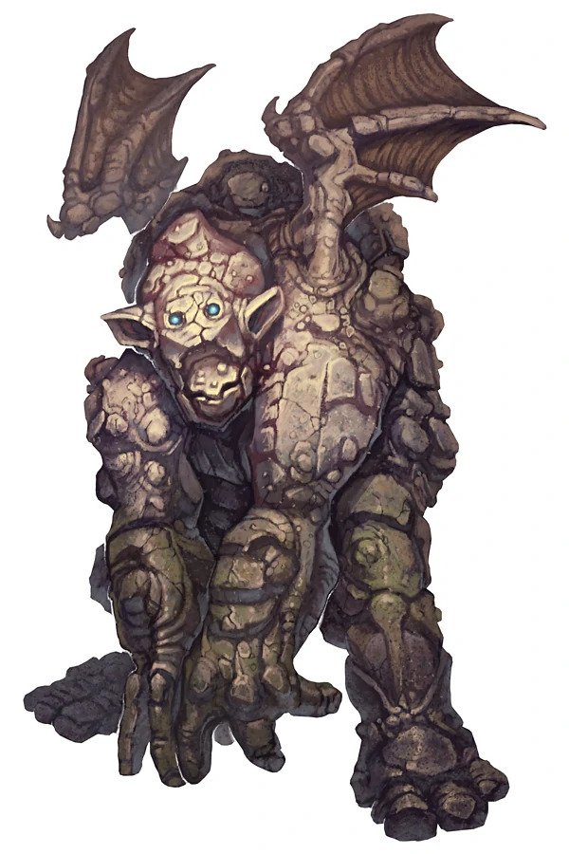
Notes:
1 - Entrance
2 - Entrance Encounter
3 - Entrance Puzzle
4 - Air Temple
5 - Earth Temple
6 - Fire Temple
7 - Water Temple

Slide 3




Notes:
1 - Entrance
2 - Entrance Encounter
3 - Entrance Puzzle
4 - Air Temple
5 - Earth Temple
6 - Fire Temple
7 - Water Temple

Slide 4
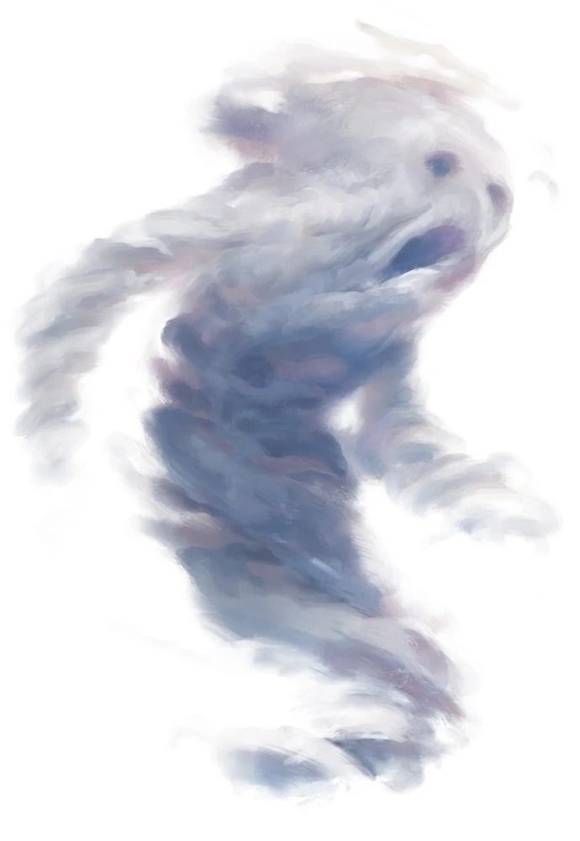

Notes:
1 - Entrance
2 - Entrance Encounter
3 - Entrance Puzzle
4 - Air Temple
5 - Earth Temple
6 - Fire Temple
7 - Water Temple

Slide 5
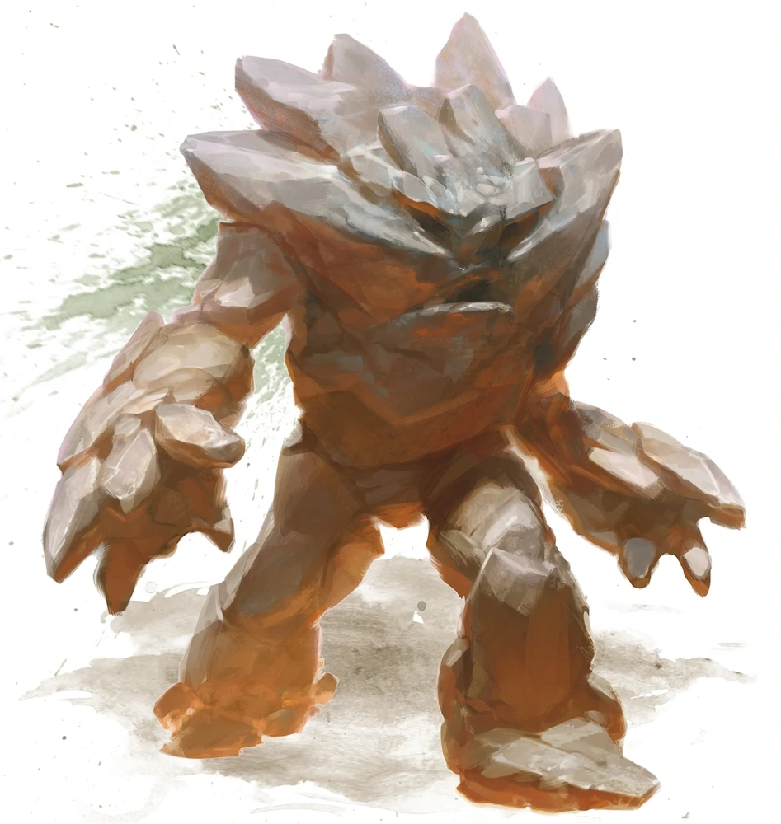

Notes:
1 - Entrance
2 - Entrance Encounter
3 - Entrance Puzzle
4 - Air Temple
5 - Earth Temple
6 - Fire Temple
7 - Water Temple

Slide 6
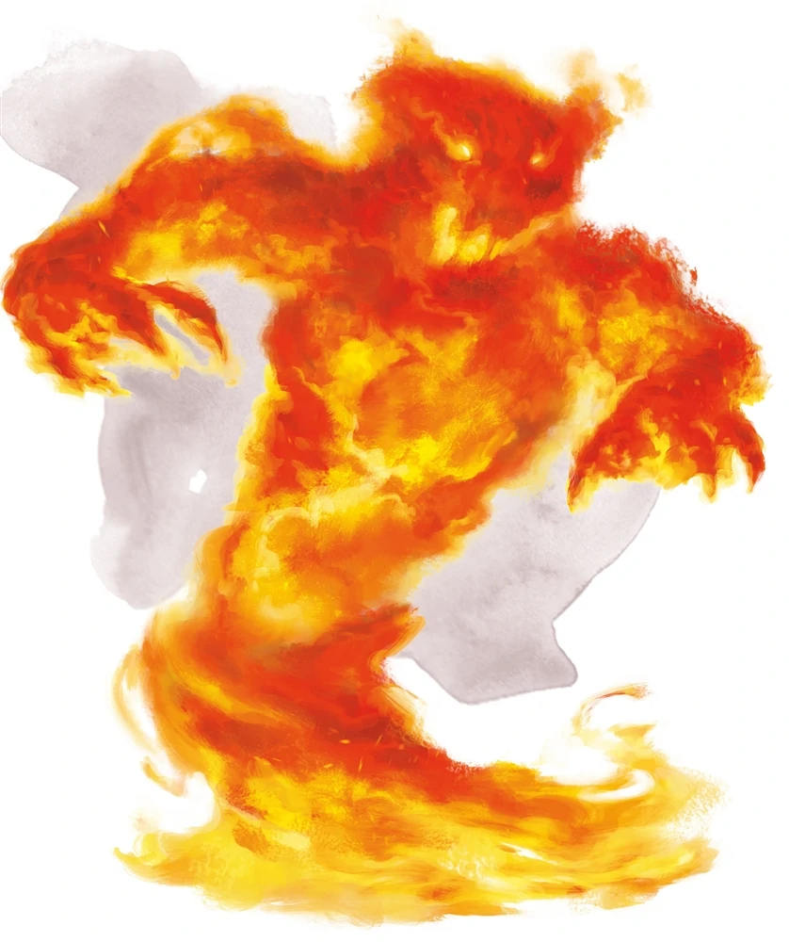
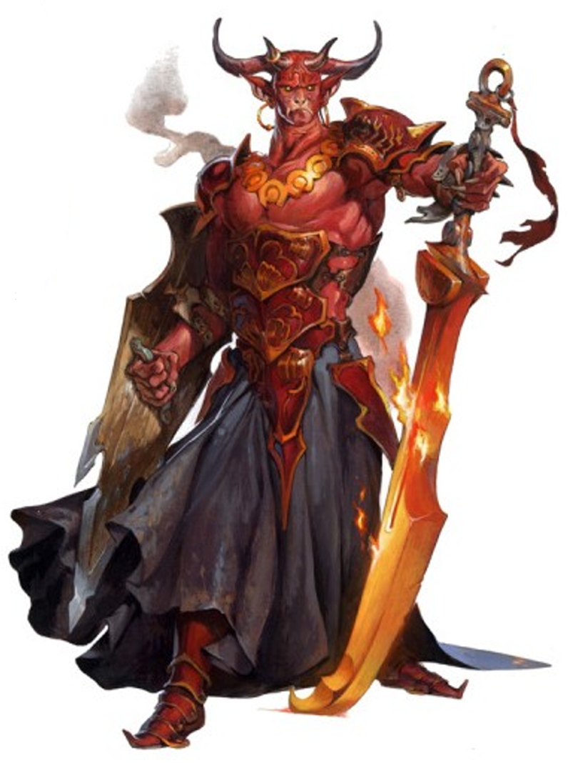
Notes:
1 - Entrance
2 - Entrance Encounter
3 - Entrance Puzzle
4 - Air Temple
5 - Earth Temple
6 - Fire Temple
7 - Water Temple

Slide 7

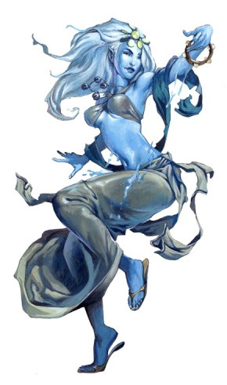
Notes:
1 - Entrance
2 - Entrance Encounter
3 - Entrance Puzzle
4 - Air Temple
5 - Earth Temple
6 - Fire Temple
7 - Water Temple

